Slide 1


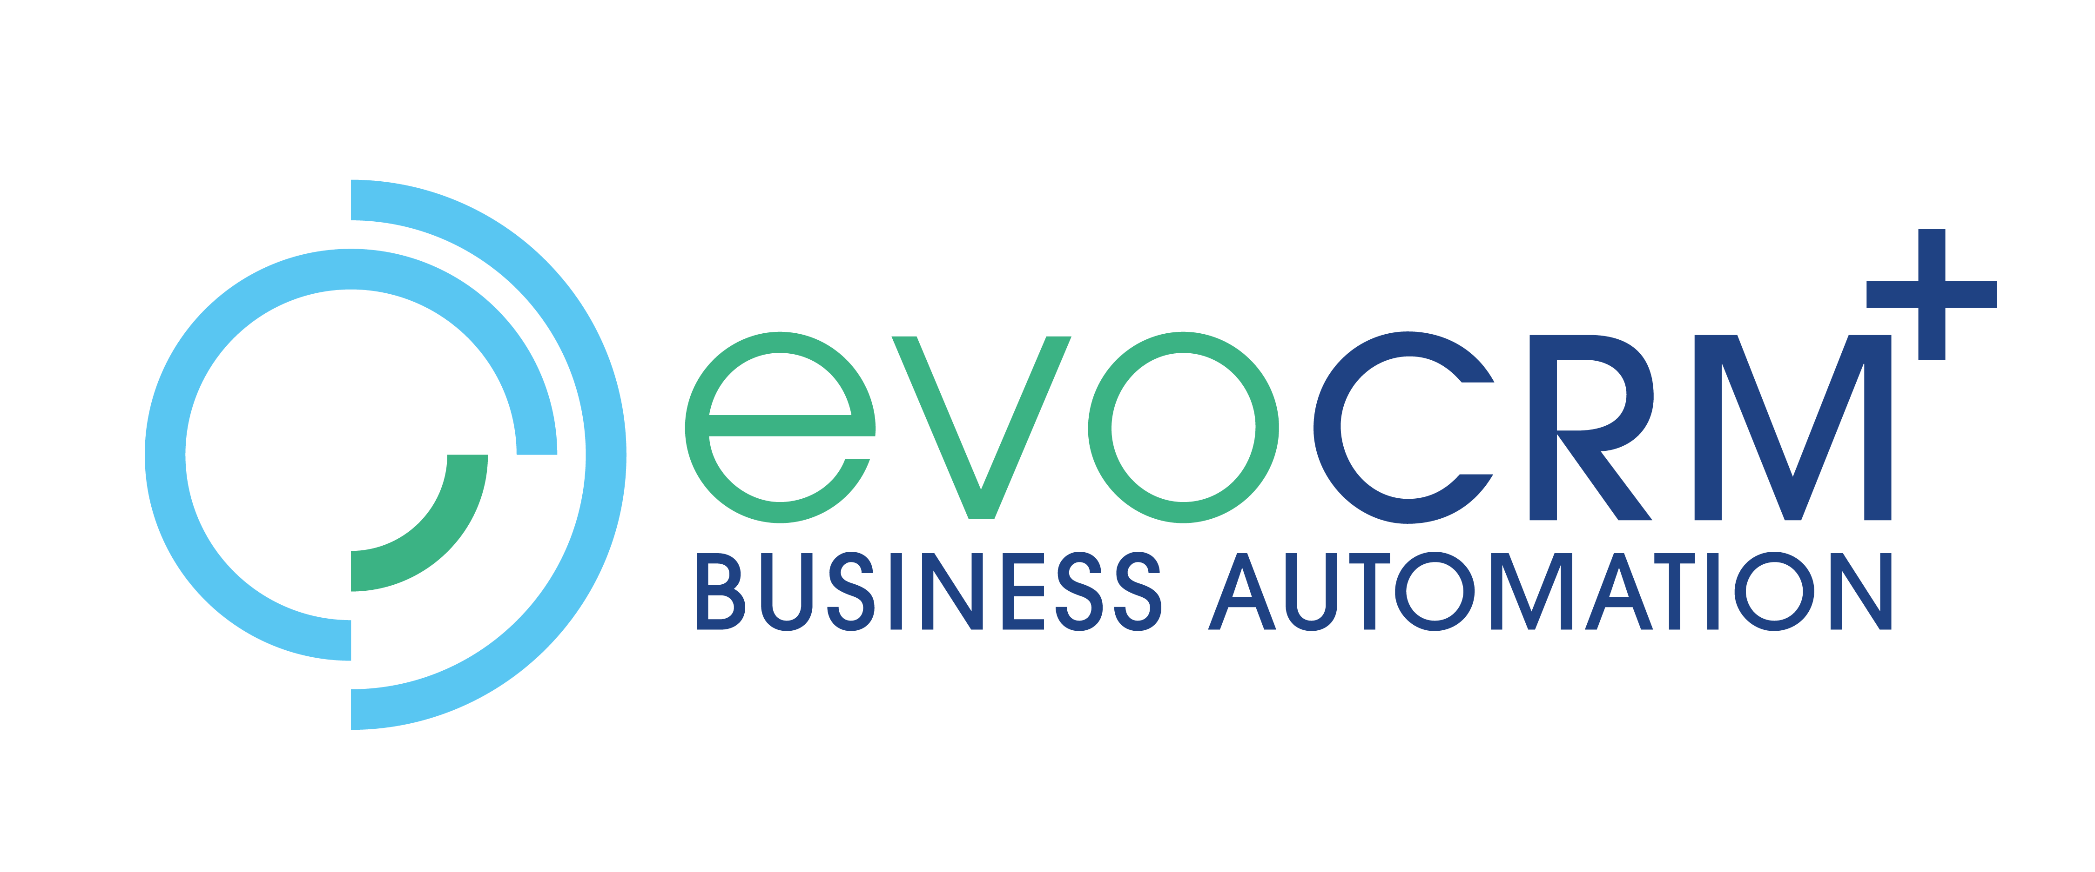














Slide 2
Dude, why would I go Pro-code, this is Power Platform
András Ódor I make things work in PowerPlatform

Slide 3
The Promise
WHEN low-code hits the wall
WHAT can pro-code do for you
HOW to start „I can’t code” doesn’t have to be permanent

Slide 4
The Low-Code Wall
Legacy APIs - SOAP api from 1995 - it looks like REST, but not really - that custom api which was slapped together by John temporarly 2 years ago
Specific UI elements - some interactive dashboard widget - editable table control
Data Integrity - nobody should be able to modify the Invoice after it’s in ‚Sent’ state - when the process fails, we must roll back all changes

Slide 5
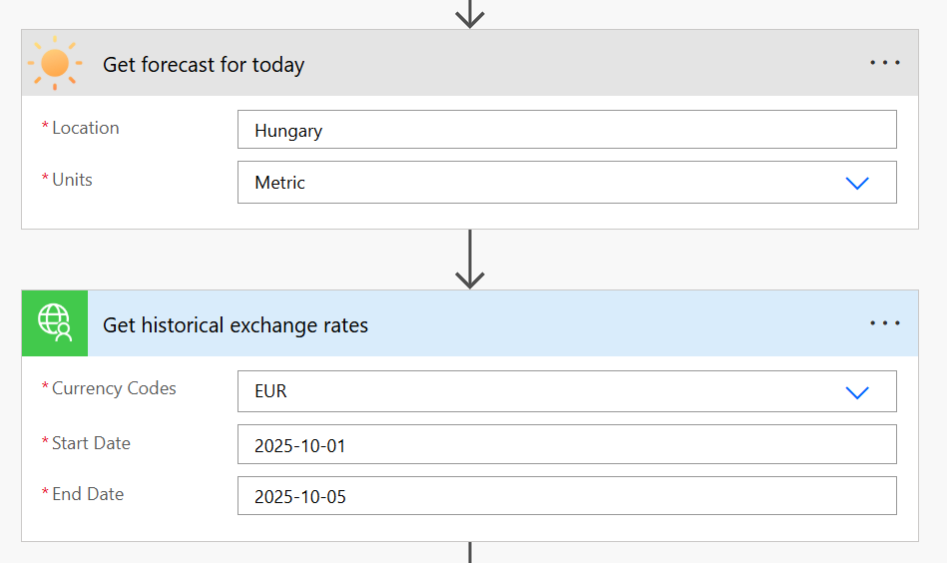
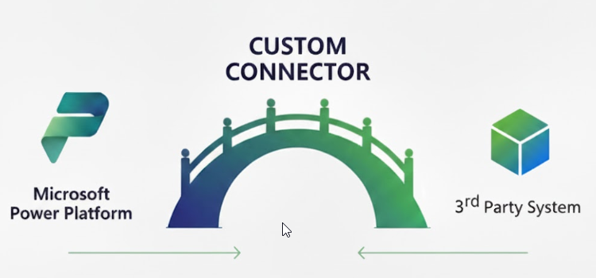
Custom Connectors Breaking the API Barrier
Predefined and encapsulated API action

Slide 6
When You Need Them
Often used APIs - Ditch the HTTP connector - No copy pasting anymore - BONUS: Better performance than multi-step flows
Simplification - Expose only the needed actions - Hide complexity - Simplified UX

Slide 7
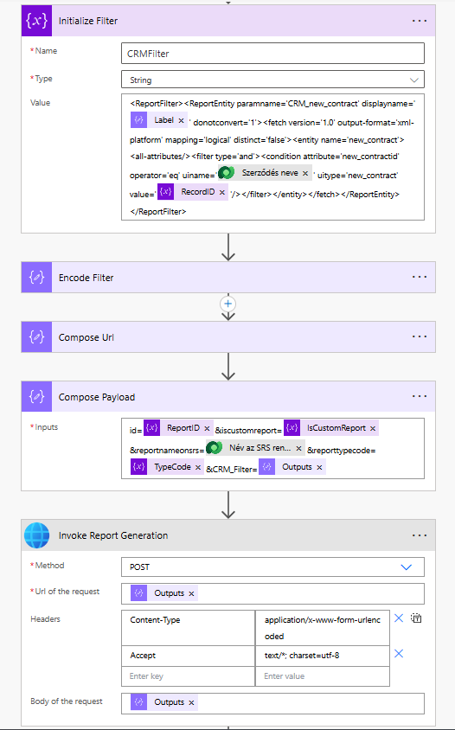
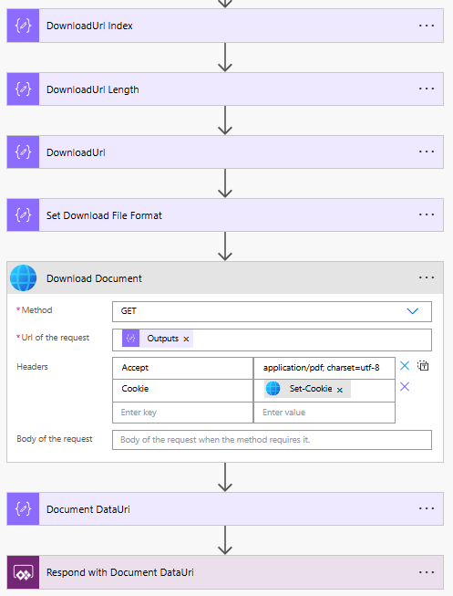
The Pain

Slide 8
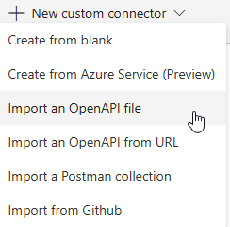
The Dream

Slide 9
The Relality
Easy
Medium
Hard
Modern REST + OpenAPI definition
Import file
Review operations
Tweak some friendly names
Test and Deploy
Zero code required
You can start today
Legacy but standard APIs
Auto generate operations from examples
Fix misshandled parameters
Tweak YAML definition
Test and Deploy
Some technical knowledge is required
Custom and/or poorly documented APIs
Manual operation setup
Code for requests / response formatting
Lot of debugging
Strong API knowledge required

Slide 10
Demo: MNB Exchange API
Hungarian National Bank exchange rates
SOAP API runnning since forever
No public connector in MS library
Notes:
"For my example, I'm using a real API - the Hungarian National Bank's currency exchange rates.
Why this one?
[Point to bullets as you go]
SOAP API running since forever - proper old-school legacy
Not in Microsoft's connector library - you're on your own
We use it internally, probably many others too
Perfect example of 'there has to be a better way.'
Now, I'm going to show you two things: First, what it looks like to USE this connector. Then I'll pull back the curtain and be honest about what it took to BUILD it."

Slide 11
Getting Started
Find a simple REST API - has „Try it” feature - has OpenAPI definition - e.g. JSONPlaceholder, Free Weather API
Import a definition - Review the operations - Give friendly names and descriptions - Use it in a real flow
Build for an actual need - Import or build manually the operations - Handle authentication - Test thoroughly

Slide 12
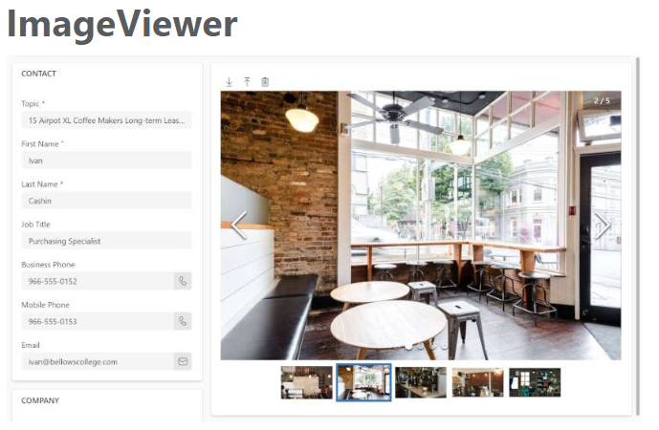
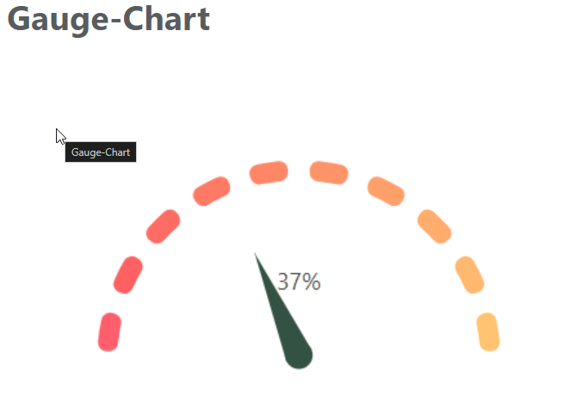
PCF Controls - When Your UI Needs More PowerApps Component Framework
Javascript framework to develop reusable Custom UI Controls

Slide 13
When You Need PCF Controls
Custom visualization - custom dashboard widgets - specialized charts
Specialized controls - custom functionality - richtext editor - editable table control
Consistent UX - works both with Canvas and Model-driven apps

Slide 14
The PCF Ecosystem
Javascript and TypeScript basics
HTML and CSS basics
React (TypeScript UI library) for complex controls
Node.js and npm for building
PCF Framework basics

Slide 15
Demo: From simple to advanced
Simple Percent control - formatted number display with color coding
Enhanced Percent control - based on the simple - with lot of css and animation enhancement
Company Lookup control - functions like a native lookup field - integrates with 3rd party Company Lookup API - pulls in data and populates it into fields

Slide 16
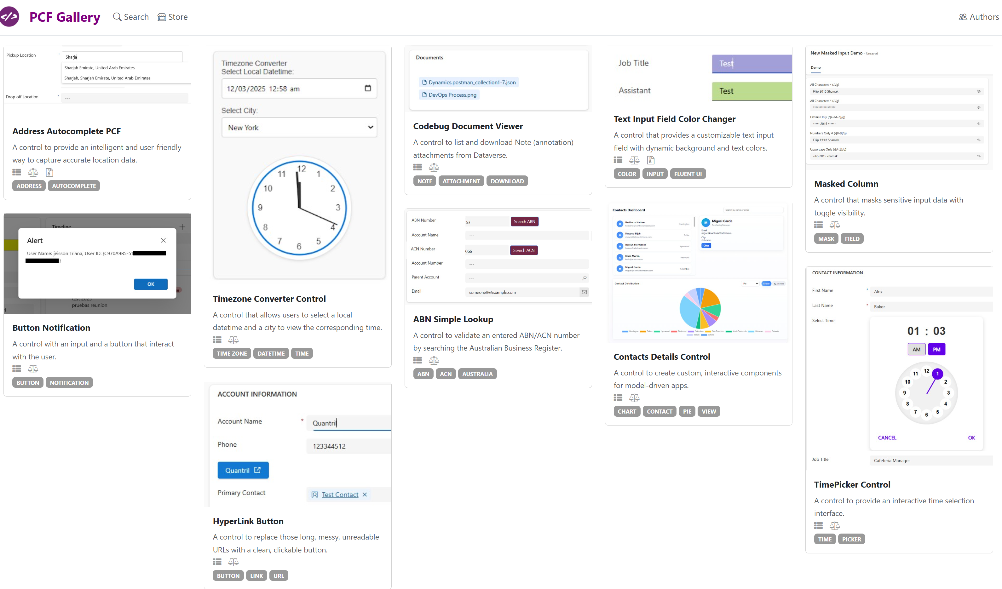
PCF Gallery

Slide 17
Getting Started
Use before build - most PCF Gallery controls are opensource and free to use - download and install a few, get a feel for it, get ideas
Tweak existing from PCF Gallery - get familiar with the PCF framework, Javascript and TypeScript
Build your own - start small, build something simple - get into the nitty-gritty of the languages - go to more complex ideas as you learn more
Visit pcf.gallery
Notes:
Time investment
30min
Few hours
As much as you spend on it few hour to weeks, depends

Slide 18
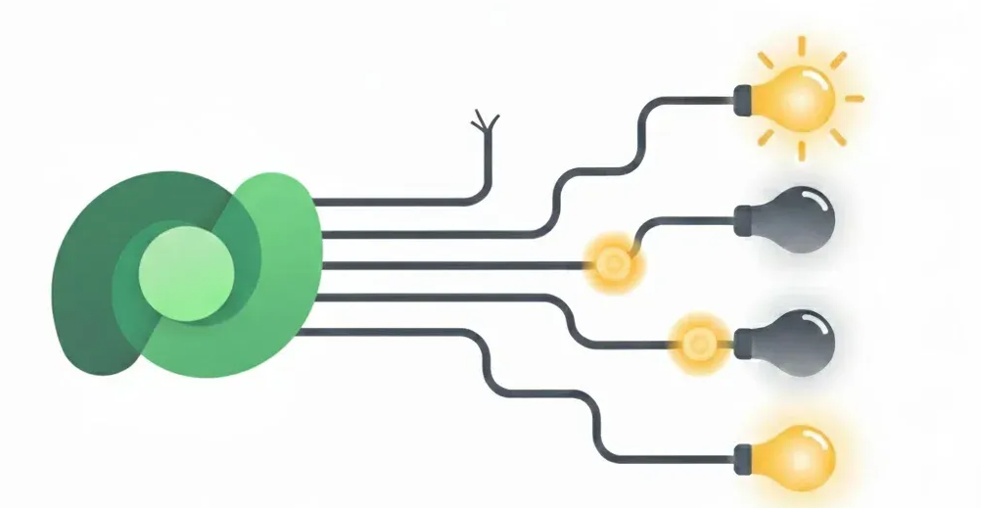
Dataverse Plugins When PA flows reach their limit
Data events trigger custom code that handles business logic.

Slide 19
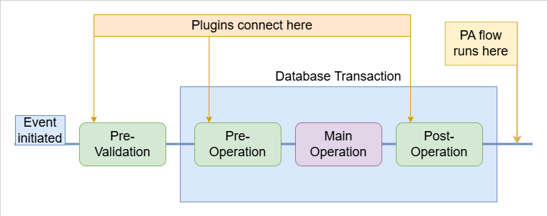
Glimpse of the Event Framework

Slide 20
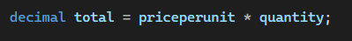
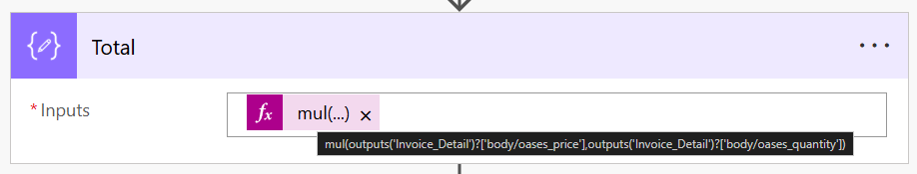
When should You consider You want to make sure, that
Validation cannot be bypassed
It runs synchronously
It runs in a database transaction
Performance-critical / bulk operations
Complex logic is readable and maintainable

Slide 21

With great power comes great responsibility
Plugins can impersonate
Make actions in the name of any user
Including SYSTEM

Slide 22
The Plugin Ecosystem
C# and .NET
OOP (class, object, inheritance,...)
Event Framework basics
Plugin Registration Tool
Other tools that documentation covers

Slide 23
Mindset is Key
This will be a lot at first
And that’s fine
What you really need - Motivation to start - Dedication to learn - Persistence to keep going
Anything else can be learned

Slide 24
Demo
Validation enforcement - Blocks invoice item changes when invoice status isn't Draft
Real-time calculation - Calculating invoice item totals on creation - Calculating invoice total on invoice item creation

Slide 25
Getting Started
Follow a tutorial - MS Learn has complete walktroughs - Avoid tutorial hell
Apply to your scenario - Take a simple validation/calculation problem - Adapt the tutorials approach to it
Build independentily - Start small, gradually increase complexity - Documentation is your best friend

Slide 26
Journey before destination
Custom Connectors
PCF
Plugins
- Mostly configuration - Minimal code - Start today
- Easy to start - Hard to master - MD and Canvas -Takes a few weeks to get confident
- High entry barrier - Most complex dev / deploy process - Can take months to get going

Slide 27
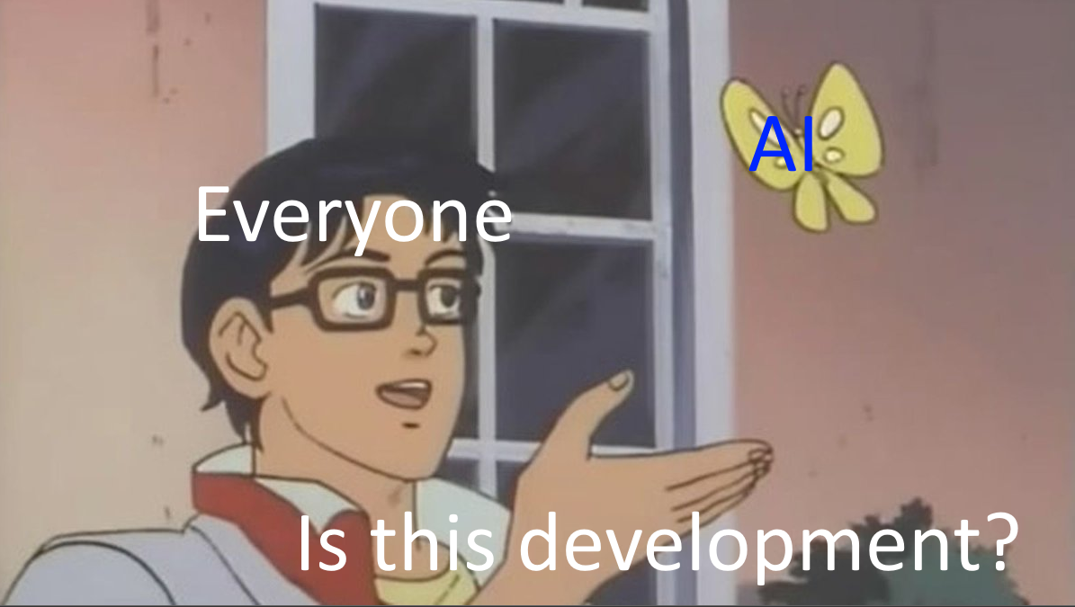
No session without AI

Slide 28
So, why go Pro-code?
To extend your toolbox
and become more capable
To proudly say:
„I made this.”

Slide 29
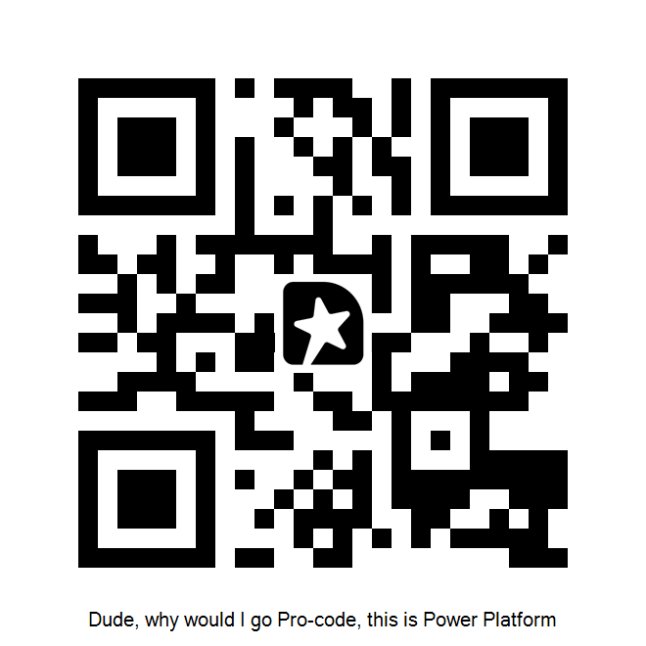
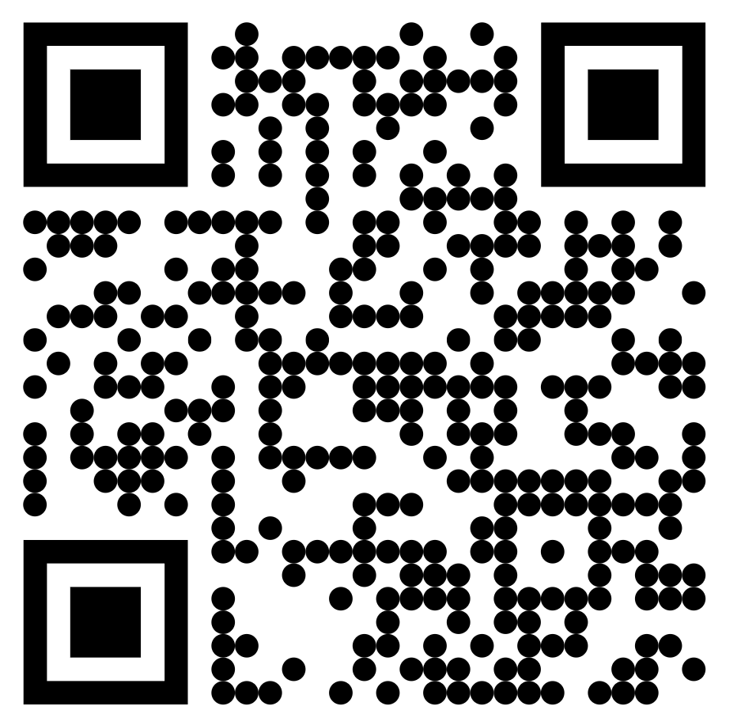

Thank you!
Session Feedback
Resources and demos
/ /odor-andras/

